Slide 1


Commercial Manufacturing of AB-101
Budgetary projection for the September Board
Capacity, lead time and cost for a dedicated seven-suite operation.
CONFIDENTIAL · 14 August 2026

Slide 2
SUMMARY
Responses to your questions
You asked | Our answer
Lead time to 7 commercially-licensed GMP suites | Technology transfer starts 2027 at 201 College Road East or East Norriton, bridging to Princeton 307 for GMP, PPQ and commercial readiness. Made Scientific's initial build-out at 307 — cleanrooms, labs, warehousing and cold storage — completes Q4 2027 – Q1 2028; the Artiva suite build runs 12–15 months from signature of the commercial agreement
Cost through Tech Transfer and PLI / 1st commercial batch (2027–2030) | $10.10M – $17.20M, with program initiation and GMP readiness fee-waived
Cost per batch at 200 L, 20 batches/suite/yr | $380K – $430K all-in — $864 – $977 per vial, inside your <$1,000 target
Suite reservation fee | $0 — against an agreed minimum annual batch commitment
Staffing | Dedicated, not shared. Included in the batch fee
Raw materials | $200K per batch, your assumption, passed through at cost
Other — semi-annual APVs, stability, storage | Included in the batch fee
Made Scientific versus other CDMOs | Made Scientific funds and equips the suites — approximately $85M of build that a standard CDMO charges to the client
Additional finding, on slide 4: the same seven rooms can support approximately 24% more output than the current plan assumes.
Artiva Biotherapeutics × Made Scientific · Confidential · 14 August 2026
2

Slide 3
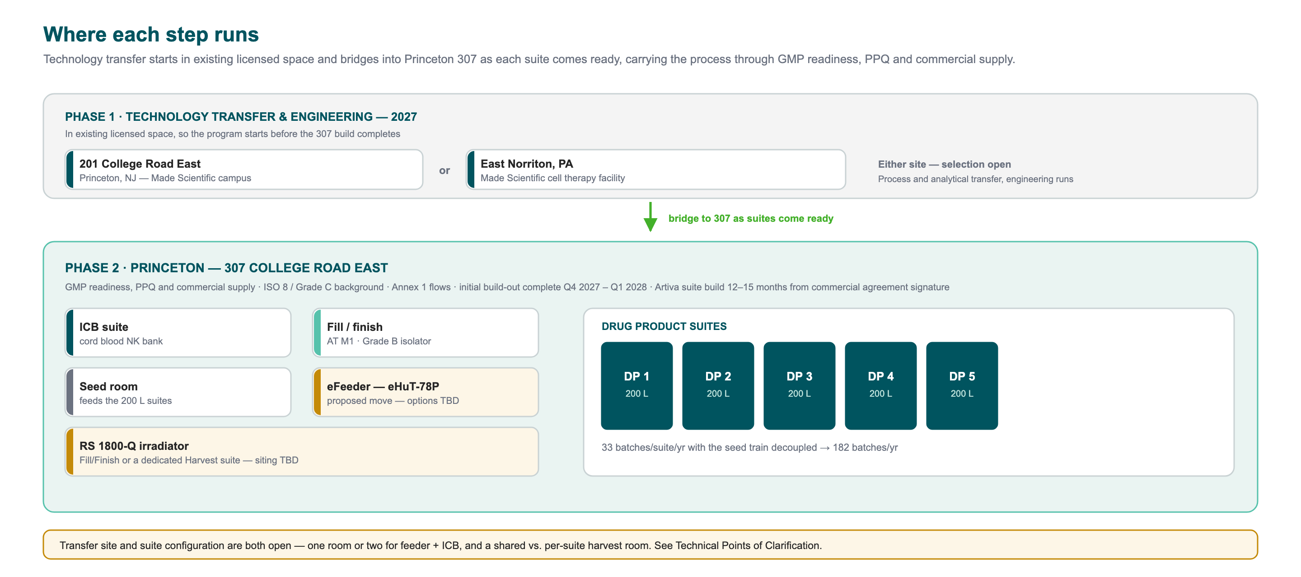
LEAD TIME
Starting now, bridging to 307
TRANSFER STARTS IN LICENSED SPACE, THEN BRIDGES INTO 307
2027
2027–28
12–15 mo
2030
Tech transfer starts
Initial build-out complete
Artiva build to GMP ready
First commercial batch
201 College Road East or East Norriton
Cleanrooms, labs, warehousing, cold storage
From commercial agreement signature
PLI-ready, on the dates you set
Artiva Biotherapeutics × Made Scientific · Confidential · 14 August 2026
3

Slide 4
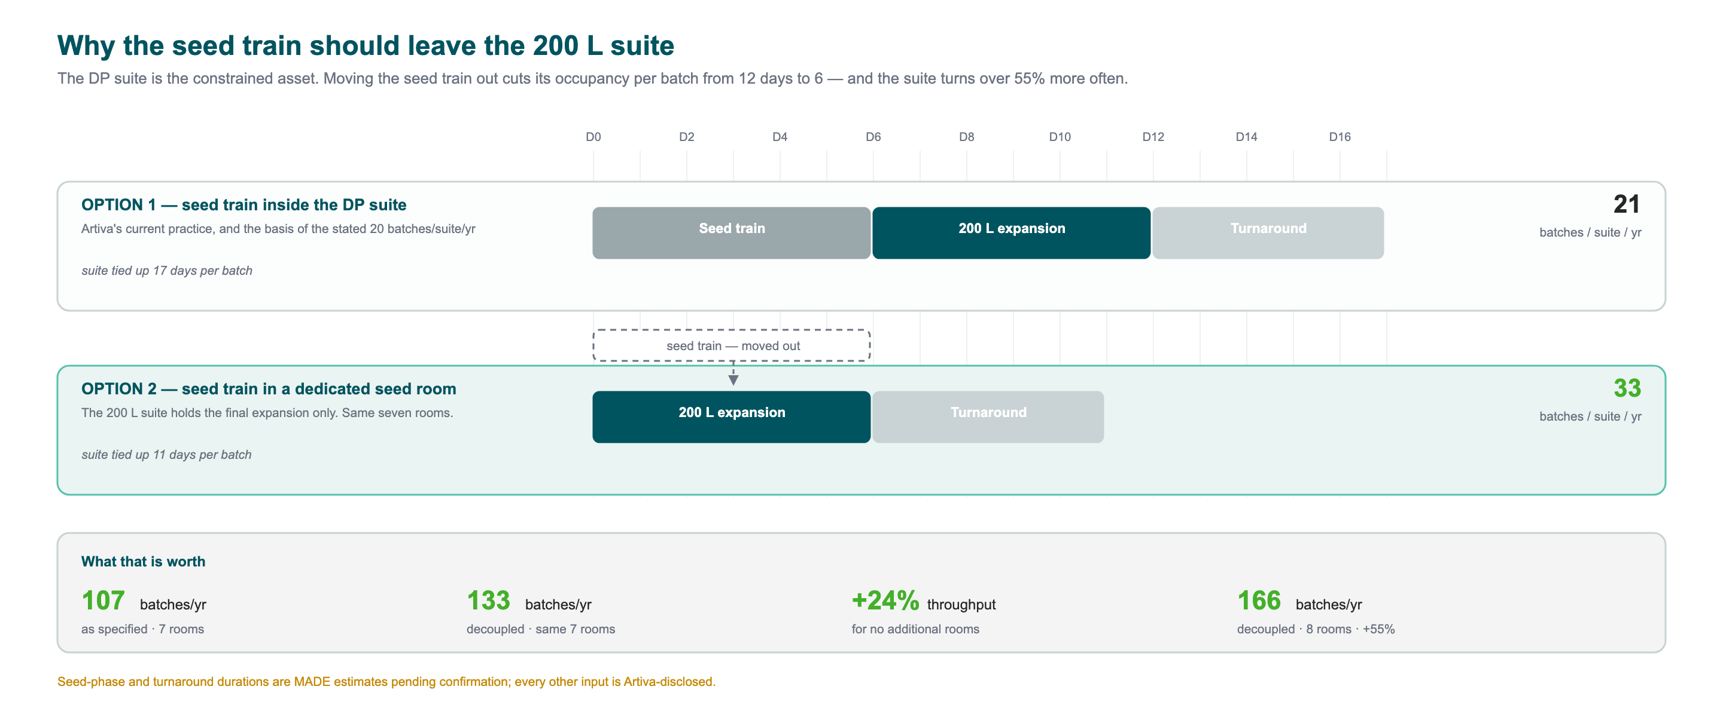
THROUGHPUT
Increasing throughput within the same seven rooms
The eFeeder suite already achieves ~60 batches a year from a 24-day campaign, because only the 9-day bioreactor step occupies the room. Apply the same logic to drug product — turn one DP suite into a seed room feeding the other four — and the same seven rooms go from 107 to 133 batches a year. Add an eighth room and it is 166.
Artiva Biotherapeutics × Made Scientific · Confidential · 14 August 2026
4

Slide 5
COST
Program cost
THROUGH TECH TRANSFER, PPQ AND PLI · 2027–2030
PER BATCH AT 200 L · TIERED ON VOLUME
Annual volume | Conversion | Materials | All-in | Per vial
up to 60 batches | $230K | $200K | $430K | $977
61 – 120 batches | $210K | $200K | $410K | $932
121 – 180 batches | $195K | $200K | $395K | $898
over 180 batches | $180K | $200K | $380K | $864
$10.10M – $17.20M
Program initiation and GMP readiness are fee-waived
Phase | Year
Technology transfer — ICB, drug product, fill/finish | 2027
Analytical method transfer, qualification and validation | 2027–28
Engineering runs and GMP readiness | 2028
Aseptic process simulation and PPQ campaign | 2029
BLA support, PLI readiness, first commercial batch | 2030
Every tier sits inside the <$1,000 per vial commercial COGS you have set publicly.
At 8 vials per patient that is $6,909 – $7,818 of drug product cost per patient, against the $8,000 in your own materials.
Suite reservation fee: $0
Charged instead as an agreed minimum annual batch commitment, aligning payment with output rather than with reserved capacity.
All figures ±30%, the tolerance you specified. Materials at $200K per batch is your assumption, carried through at cost.
Artiva Biotherapeutics × Made Scientific · Confidential · 14 August 2026
5

Slide 6
WORK PACKAGE BREAKDOWN
The same total, by milestone
The identical $10.10M – $17.20M from the Cost slide, decomposed to milestone granularity through Pre-License Inspection to commercial manufacturing.
Milestone | Year | Low | High | Basis
M1 · Program Initiation & Knowledge Transfer | 2027 | Waived |  | Fee waived — as on the eHuT-78P program
M2 · Technology Transfer — Process & Analytical | 2027 | $4.90M | $7.90M | ICB, drug product and fill/finish process transfer; analytical method transfer
M3 · GMP Readiness | 2028 | Waived |  | Fee waived — as on the eHuT-78P program
M4 · Engineering Runs | 2028 | $1.60M | $2.60M | ICB and drug product engineering runs
M5 · Aseptic Process Qualification | 2029 | $450K | $750K | 3 consecutive media fills; semi-annual APS thereafter sits in the batch fee
M6 · Process Performance Qualification | 2029 | $1.90M | $3.80M | eFeeder, ICB, DP and fill/finish PPQ — 3 consecutive successful batches each
M7 · Regulatory & PLI Readiness | 2029–30 | $750K | $1.25M | CMC authoring, PLI prep, mock inspection
M8 · Stability Program | 2027–30 | $500K | $900K | ICH stability protocol, pulls, reporting
M9 · Commercial Manufacturing & Lifecycle | 2030+ | $380K | $430K | All-in per batch under the volume-tiered schedule — see the Commercial Forecast
M1–M8 total: $10.10M – $17.20M, matching the Cost slide exactly. M9 is priced per batch, not a fixed fee — forecast by configuration on the next slide.
Artiva Biotherapeutics × Made Scientific · Confidential · 14 August 2026
6

Slide 7
COMMERCIAL FORECAST
Volume-based discount, by configuration
Structured the way a volume-discount schedule should read: as commitment grows, the batch fee steps down. Anchored to Made Scientific's throughput options rather than an Artiva demand forecast, as drug product volumes have not been shared.
Illustrative year | Configuration | Ceiling | Commitment | Committed batches | Batch fee | Minimum annual fee | $/vial
2030 (PLI & launch) | Option 1 | 107 | 50% | 54 | $230K | $12.42M | $977
2031 | Option 2 | 133 | 65% | 86 | $210K | $18.06M | $932
2032 | Option 3 | 166 | 80% | 133 | $195K | $25.93M | $898
2033+ | Option 4 | 265 | 90% | 238 | $180K | $42.84M | $864
The fee steps down as committed volume scales — $230K → $210K → $195K → $180K per batch — and every step remains inside your <$1,000/vial commercial COGS target. Materials pass-through is additional at $200K/batch and is not part of the minimum fee.
ASSUMPTIONS STATED EXPLICITLY, NOT IMPLIED
The 2030→2033+ year mapping is Made Scientific's proposed adoption sequence, not a commitment Artiva has made. Commitment levels (50/65/80/90%) are illustrative, not yet negotiated. Batch fees are read from the §2 tier schedule at each year's committed volume, not the configuration's ceiling — you do not get bulk-tier pricing on capacity you have not committed to. The interactive site carries a 5-year ramp you can adjust yourself.
Artiva Biotherapeutics × Made Scientific · Confidential · 14 August 2026
7

Slide 8
COMMERCIAL MODEL
Commercial model comparison
 | A standard CDMO | Made Scientific
Facility build-out | Charged to you — est. $30M–$40M | Absorbed
Suite fit-out and process equipment | Charged to you — est. $45M–$55M | Absorbed
FTEs / labor | Hire and manage your own — est. $7M–$11M/yr for a dedicated ~45–55 FTE team | Included in the batch fee — no separate hire
Suite reservation fee | Charged, and non-refundable | $0 against a volume commitment
Program initiation | Charged | Waived
GMP readiness (APQ, CQV, equipment maintenance & calibration, EMPQ, etc.) | Charged | Waived
Dedicated program management | Charged — est. $15K/month | Included
Capacity | Shared, multi-client | Dedicated suites
WHY THIS MATTERS FOR A BUILD-VERSUS-BUY DECISION
A seven-suite build is roughly $85M — our own estimate of $30M–$40M facility shell plus $45M–$55M suite fit-out and process equipment. Your FY2025 accounts show $2.6M of property and equipment purchases and $874K of leasehold improvements in total — this would be a capital project about a hundred times anything Artiva has undertaken.
Made Scientific funds both. FTEs are dedicated, not billed separately — their cost sits inside the per-batch fee on the Cost slide, not this comparison.
Artiva Biotherapeutics × Made Scientific · Confidential · 14 August 2026
8

Slide 9
Appendix
Process flow, suite floor plan, production strategy options, the open variables, and the basis of estimate.

Slide 10
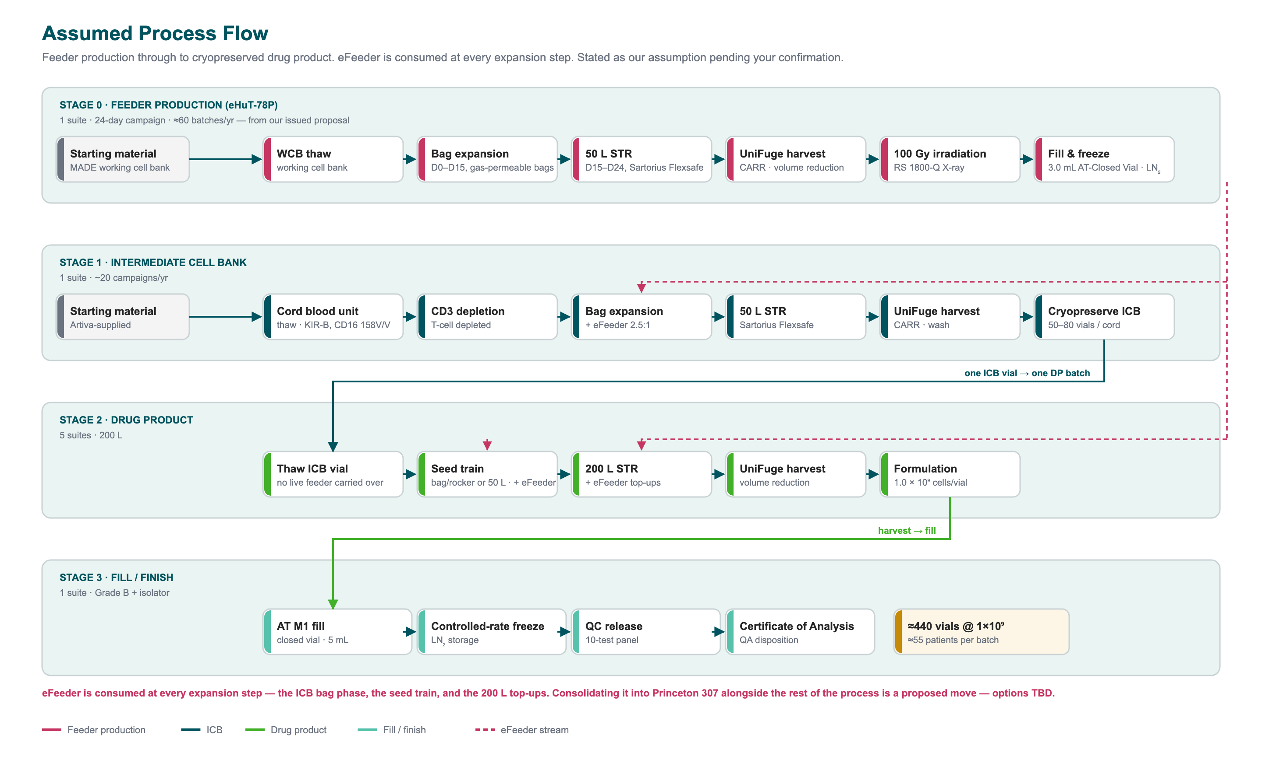
APPENDIX A1
Assumed Process Flow
eFeeder has no suite in the seven-room plan as originally specified. Consolidating its production into 307 alongside the rest of the process is a proposed move — options TBD.
Artiva Biotherapeutics × Made Scientific · Confidential · 14 August 2026
9

Slide 11
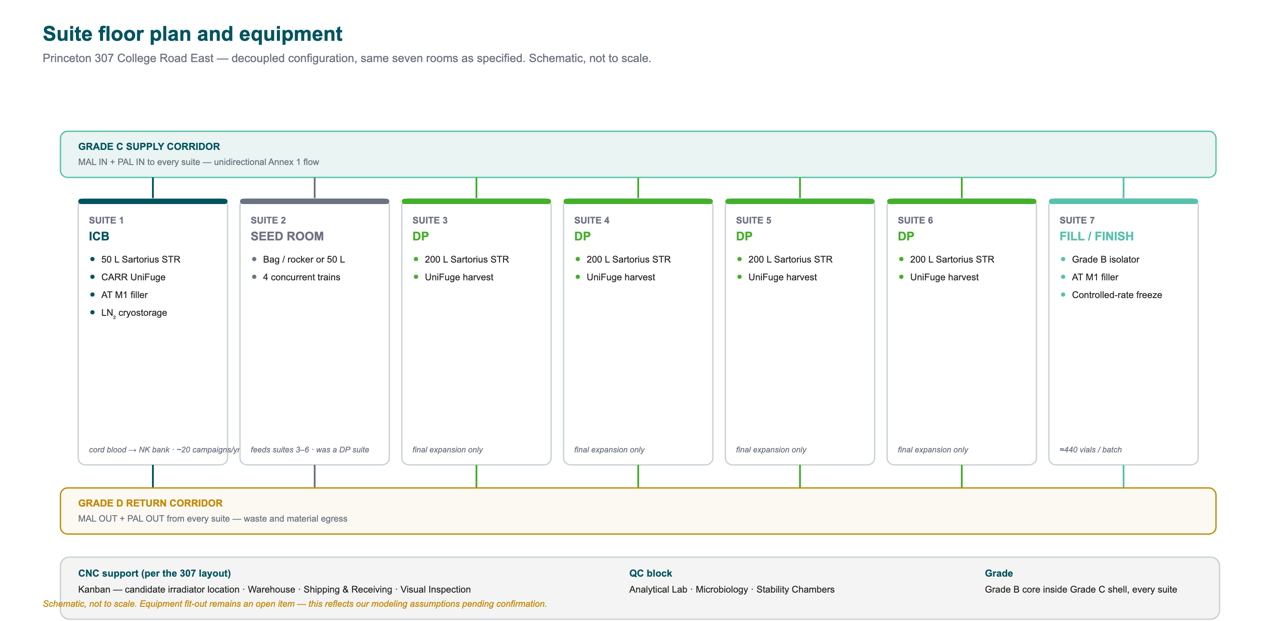
APPENDIX A2
Suite floor plan and equipment
Schematic, not to scale, based on the 307 layout — decoupled configuration, suite 2 converted from drug product to a shared seed room. Equipment fit-out remains an open item; this reflects our modeling assumptions pending confirmation.
Artiva Biotherapeutics × Made Scientific · Confidential · 14 August 2026
10

Slide 12
APPENDIX A3
Production strategy options
 | Strategy | Rooms | Batches/yr | Patients/yr | Annual conversion cost
1 | As specified — 1 ICB + 5 DP + 1 F/F, seed in-suite | 7 | 107 | 5,885 | $19.3M
2 | Decoupled seed — same seven rooms | 7 | 133 | 7,315 | $23.9M
3 | Decoupled seed — one additional room | 8 | 166 | 9,130 | $26.6M
4 | East Norriton ballroom build | 12 | 265 | 14,575 | $37.1M
Patients per year assume the proposed Phase 3 regimen of two 4-billion-cell doses, i.e. 8 vials per patient. Your stated commercial reach — 250 clinics at 1–2 patients a month — is 3,000 to 6,000 patients a year, so Option 1 already covers the launch plan and the others create headroom. eFeeder was never one of the seven rooms; consolidating its production into 307 is a proposed move, options TBD.
Decoupling the seed train moves the constraint onto the seed room. One seed room running four concurrent trains supports about 182 batches a year, so Option 4 needs a second — without it, eight drug product suites are throttled to 182.
Artiva Biotherapeutics × Made Scientific · Confidential · 14 August 2026
11

Slide 13
APPENDIX A4
Key sensitivity: NK seed density
Irradiated feeder cells do not replicate, so every drug product batch consumes them at seed and again at each top-up. Our working assumption puts feeder seeding density at 2.5:1 against CD3⁻CD56⁺ NK cells, which leaves the NK seed for a 200 L run as the open variable.
NK expansion | NK seed for 440B | Feeders at 2.5:1 | DP batches per feeder run | Feeder suites needed
100× | 4.4B | 11.0B | ~1.4 | 1.2
250× | 1.8B | 4.4B | ~3.4 | 0.5
500× | 0.9B | 2.2B | ~6.8 | 0.2
1000× | 0.4B | 1.1B | ~13.6 | 0.1
One dedicated feeder suite covers the full program unless NK expansion runs below about 100-fold. Confirming the NK seed density and the number of feeder top-ups would let us replace this table with a single number.
Artiva Biotherapeutics × Made Scientific · Confidential · 14 August 2026
12

Slide 14
APPENDIX A5
Basis of estimate
Input | Value | Source
Drug product batch yield | ~440 vials at 1×10⁹ cells | Linear 4× from ≥110B at 50 L (Cytotherapy, 2026)
Batch duration | 11–13 days | Your process summary, August 2026
Batches per suite per year | 20 (in-suite seed) / 33 (decoupled) | Your San Diego operating rate; decoupled figure is our estimate
Feeder campaign | 24 days, ~60 batches/yr per suite | eHuT-78P process and our East Norriton suite assessment
Feeder : NK seeding ratio | 2.5 : 1 | Our working assumption
Dose | 2 × 4 billion cells, 8 vials per patient | Proposed Phase 3 design, 8-K of 8 May 2026
Materials per batch | $200,000 | Your assumption
Commercial COGS ceiling | <$1,000 per 1B-cell vial | Artiva public statements, 200 L process
Estimates pending confirmation: the split of the 11–13 day batch between seed train and 200 L expansion, suite turnaround time, and NK seed density. These move the throughput figures; they do not change the commercial structure.
Artiva Biotherapeutics × Made Scientific · Confidential · 14 August 2026
13

Slide 15
CLOSE
Next steps
1
Confirm the process assumptions
A short technical session on seed-train duration, suite turnaround and NK seed density would replace our estimates with your numbers and tighten the ±30%.
2
Resolve the suite configuration
Transfer starts at 201 College Road East or East Norriton and bridges into 307. Consolidating eFeeder into 307 is a proposed move, options TBD — and raises one room or two for feeder + ICB, and shared vs. per-suite harvest.
3
Capacity reservation
A reservation agreement secures a technology transfer slot and suite capacity, and is credited in full against work orders.
4
Detailed proposal
On your word we convert this into a work-order-level proposal with a full Gantt to first commercial batch.
Artiva Biotherapeutics × Made Scientific · Confidential · 14 August 2026
14

